Slide 1

HISTORY OF THE EMERGENCE OF INDEPENDENT BANGLADESH
Dr. Md. Abdul Alim
B. A (Hon’s), M. A (History), M. Phil (Raj), Ph. D (Raj)
Email:doctorabdulalim64@gmail.com
Cell: +880 01718-787466

Slide 2
DISCUSSION CONTESTS
Bengal under the Mughals
The History of Barabhuyinas
The Mughal Rule in Bengal: Rule of the Subadars & Rule of the Nawabs
The Rule of the Subadars in Bengal
Administration – Mughal Period
Subah
Sarkars
Mahals or Parganas

Slide 3
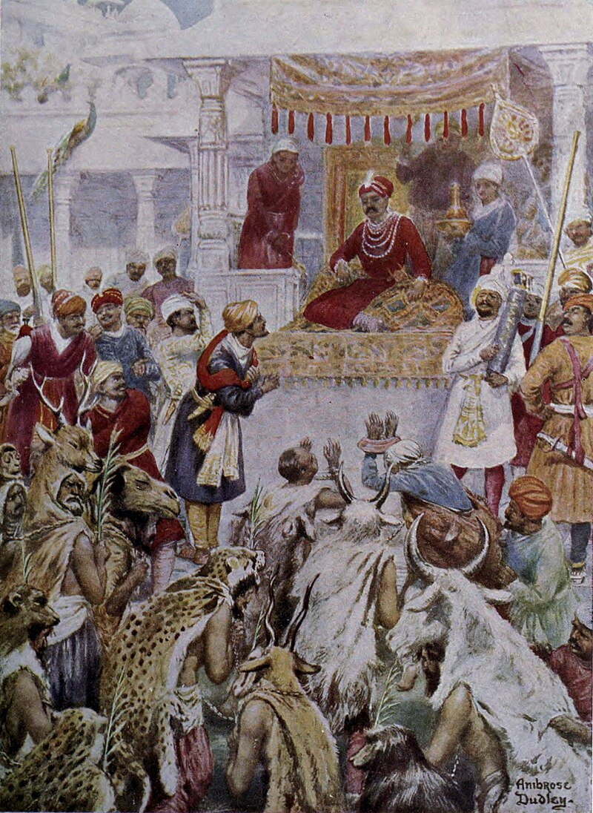
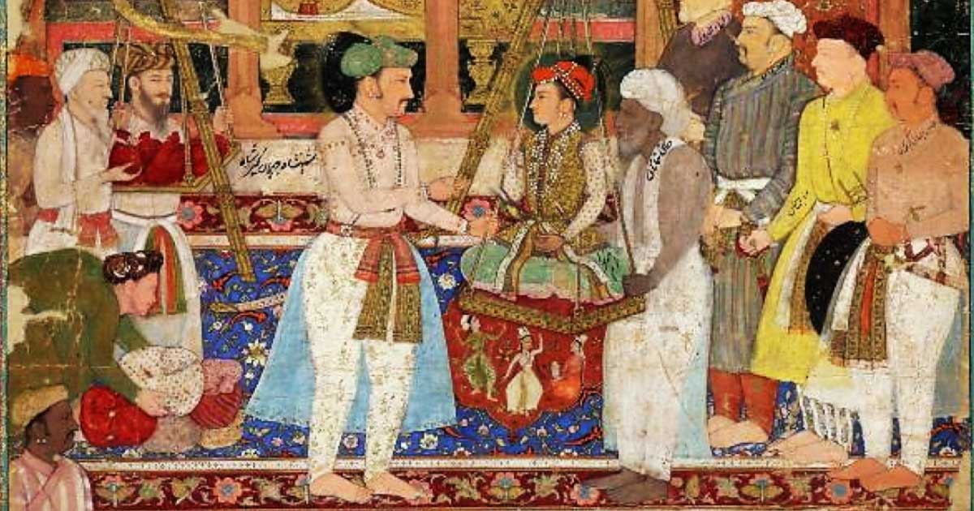
BENGAL UNDER THE MUGHALS
The Muslim rule in Bengal continued for five centuries and a half. Muslim rule began in 1204, through the conquest of Bakhtiyar Khalji. The period ended in 1757 after the battle of Plassey. After the battle, the British East India Company became the controlling power in Bengal’s politics and administration.
The period of Muslim rule is divided into two phases – Sultanate and Mughal. The sultanate period ended in 1576 when the last Afghan Sultan Daud Khan Karrani was defeated in the battle of Rajmahal by Khan Jahan, the general of great Mughal emperor Akbar.
The Mughal army controlled and established authority over a small portion surrounding the capital city named Tanda. They kept open and safe their supply baseline to Delhi but the rest of Bengal was controlled by independent and semi-independent military chiefs, the Afghans, Bengali Bhuiyans and Rajas.

Slide 4
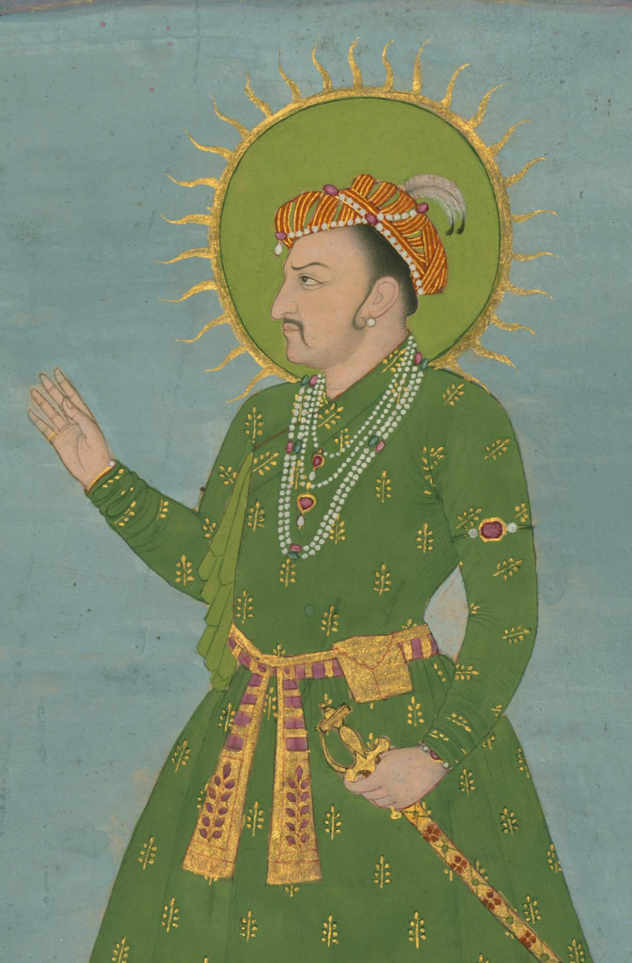
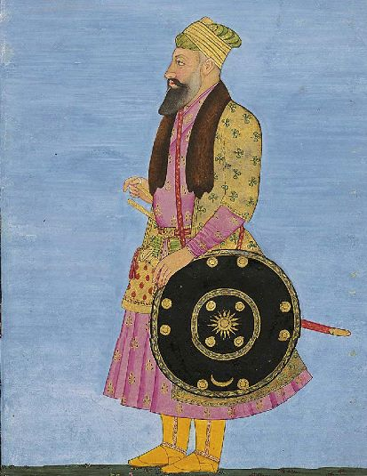
BENGAL UNDER THE MUGHALS
Akbar made strenuous efforts by sending general after general, to bring the whole of Bengal under his control but failed. His dream of conquering Bengal was fulfilled in the reign of his son Jahangir by a young, energetic Subahdar, Islam Khan.
Jahangir’s first few years remained static in the Mughal advance to Bengal. But with the appointment of Islam Khan as Subahdar in 1608, the situation was completely changed. Islam Khan took the initiative to identify the weak points of Mughal emperors and the strengths of the enemies. Joining his office in the then capital Rajmahal, Islam Khan decided to take the following steps:

Slide 5
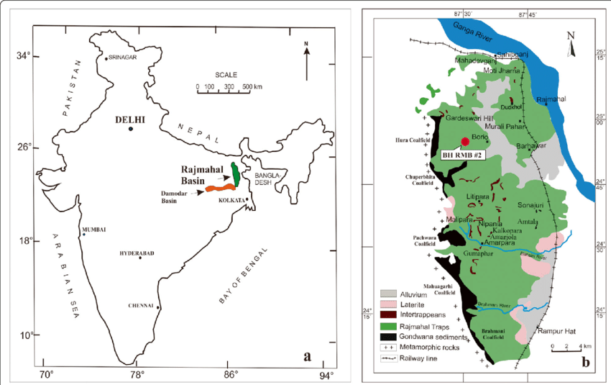
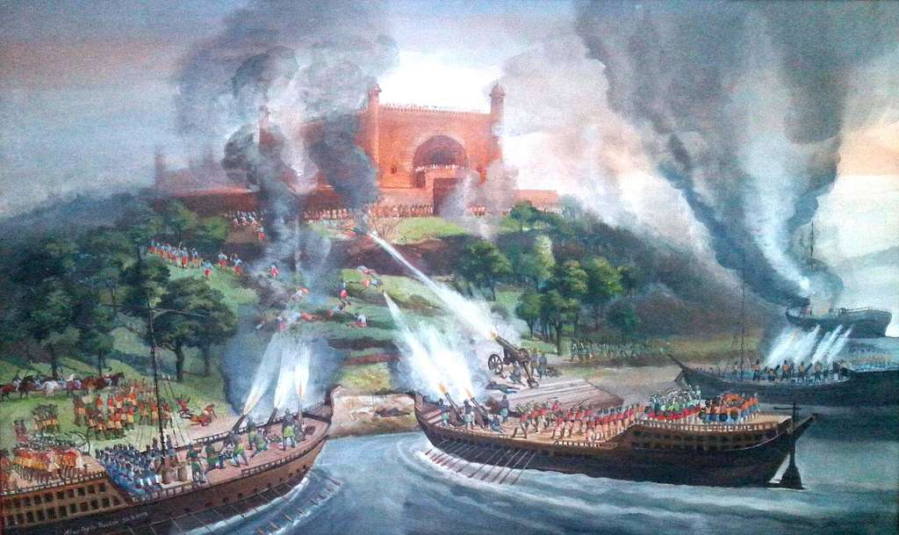
BENGAL UNDER THE MUGHALS
Transferring capital: At first, he decided to transfer the capital from Rajmahal. As he found that the strength of their enemies lay in Eastern Bengal, he decided to transfer the capital to a suitable eastern strategic place. He chose Dhaka as the ultimate capital which was situated in the heart of Bhati.
Strengthening Mughal Navy: He strengthened the Mughal navy. The Bara Bhuiyans were strong in river warfare. So, the Mughal navy was organized in such a way. He started with his numerous boats and artillery from Rajmahal towards Bhati.
Subjugating the enemies: On the way to Bhati he subjugated the Jamindars and Chiefs of surrounding areas. After reaching there he subjugated the Bara Bhuiyans. By the end of 1612 the whole of Bengal except Chittagong was brought under Mughal control.

Slide 6
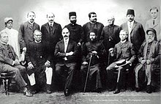
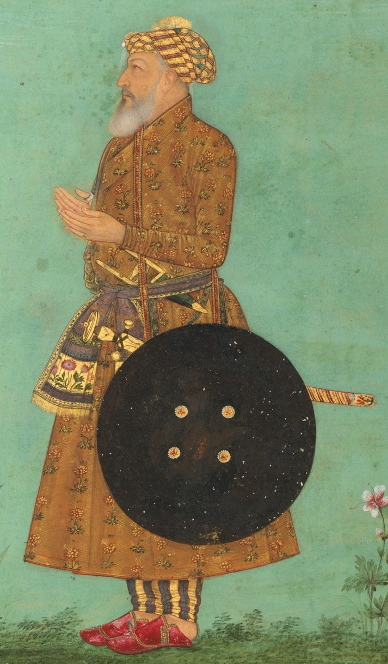
BENGAL UNDER THE MUGHALS
Reinstating the enemies: The Rajas, Jamindars and Bhuiyans were reinstated in their position on the promise of remaining loyal and paying tribute. But as soon as the Mughal army retraced their steps they shook off allegiance, gathered fresh strength and became independent.
Final successful strategy: Islam Khan examined the situation very carefully. He did not allow the defeated chiefs to go back to their station and forced them into Mughal service. They were compelled to fight against their brethren.

Slide 7
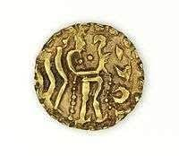
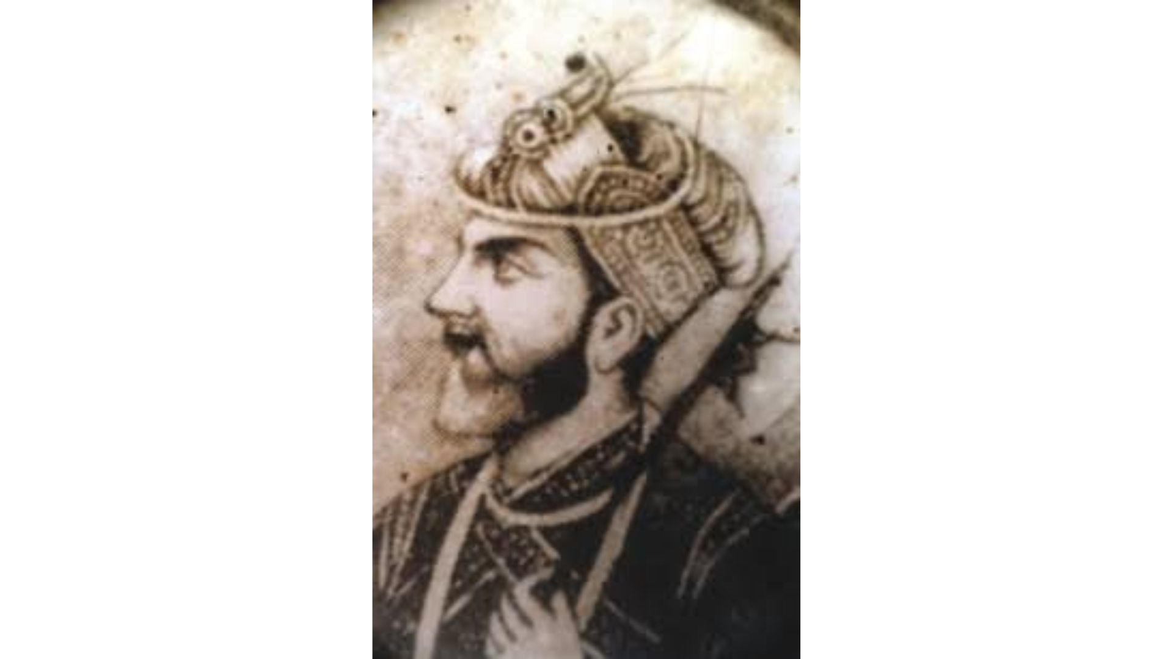
THE HISTORY OF BARABHUYINAS
Emperor Akbar could not establish authority over the whole of Bengal. The big Zamindars of Bengal did not accept the subordination of the Mughals. The independent and powerful Zamindars fought united against the Mughal commanders to protect their land. They were known as Barabhuyinas, where ‘Bara’ does not mean the number of twelve, rather defines the indefinite number of Zamindars.
Issa Khan was the Zamindar of Sonargaon, the low land known as ‘Vati’ region and the leader of Barabhuyinas. He was loyal to the Karrani Dynasty. The Gazi family established their Zamindari in Bhawal before the conquest of Bengal by Sher Shah. Similarly, big Zamindaries were established in the regions of Faridpur, Sylhet, Mymensingh, Vikrampur, Barisal, Noakhali, Manikganj, etc.

Slide 8
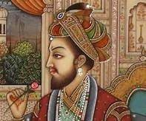
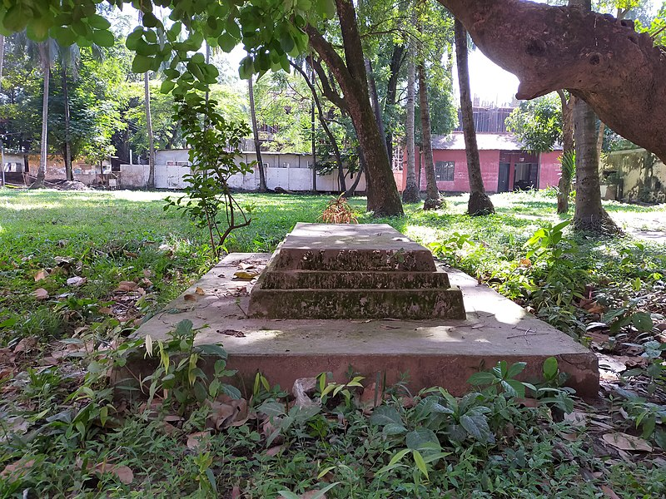
THE HISTORY OF BARABHUYINAS
Emperor Akbar gave special attention to subdue the Barabhuyinas. He sent Shahbaz Khan in 1583 A.D., Sadiq Khan in 1585 A.D., Uzir Khan in 1586 A.D. and Raja Mansingh in 1594 A.D. as Subadars in Bengal. They fought a number of battles with Issa Khan and other Zamindars. But they could not defeat him. After Issa Khan’s death in 1599 A.D. his son Musa Khan became the leader of the Barabhuyinas. Mansingh was sent to Bengal for the second time in 1601 A.D. But he had to return to Delhi hearing the news of Akbar’s illness before the final success achieved.
After the death of Akbar, Jahangir became the Mughal Emperor. During his reign Barabhuyinas were subdued completely. The claimant of the success was Subadar Islam Khan (1608-1613 A.D.). He shifted the capital of Bengal from Rajmahal to Dhaka with the intention of suppressing the Barabhuyinas. Musa Khan’s base was at Sonargaon, not far from Dhaka.

Slide 9

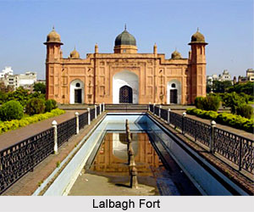
THE HISTORY OF BARABHUYINAS
On his way from Rajmahal to Dhaka, Islam Khan won the allegiance of many Zamindars on the way. He built a strong navy to face the Barabhuyinas. The first fight with Musa Khan took place in 1609 A.D. in Jatrapur on the eastern bank of the River Karotoa. Musa Khan had a fort there. In the battle that followed, Musa Khan and other Zamindars were forced to retreat. Islam Khan entered Dhaka in 1610 A.D. From this time Dhaka became the capital of Bengal and was named Jahangirnagar after the Emperor.

Slide 10


THE HISTORY OF BARABHUYINAS
The naval force of the Zamindars assembled on the river Sitalakhya under the leadership of Musa Khan. The fort ‘Kadam Rasul’ of Musa Khan, situated on the eastern bank of the river was captured by the Mughals. Musa Khan retreated to Sonargaon. The Mughal soldiers finally occupied Sonargaon. Thereafter the Zamindars were forced to surrender. Subadar Islam Khan was very generous. He behaved very courteously with Musa Khan. He appointed Musa Khan in his own Zamindari as a representative of the Mughals. Musa Khan passed the rest of his life as a loyal representative of the Mughals. Many Zamindars were disappointed at the surrender of Musa Khan. After that all other Zamindars pledged allegiance to the Mughals one after another. This ended the rule of the Barabhuyinas.

Slide 11
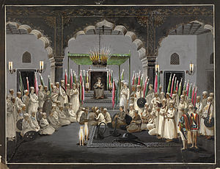
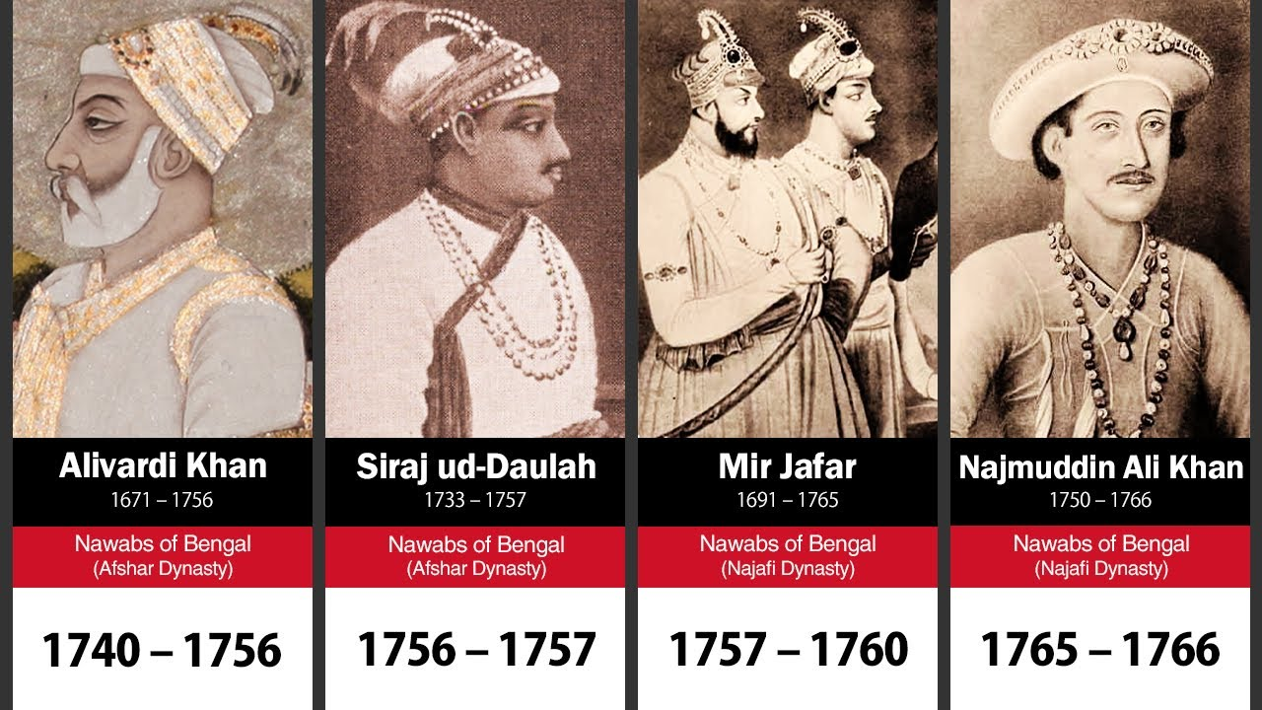
THE MUGHAL RULE IN BENGAL
The rule of the Mughals in Bengal was divided into two periods.
Rule of the Subadars: The Mughal provinces were known as ‘Subas’. Bengal became a Suba after the defeat of the Barabhuyinas. Its golden phase was from early seventeenth to early eighteenth century. After Aurangzeb, the Mughal rule in Bengal became weak in the hands of his weak successors. Taking advantage of this, the Subadars of Bengal were ruling independently.
Rule of the Nawabs: The independent rule of the Subadars is known as the rule of the Nawabs. This continued up to 1757 A.D. for almost half a century.

Slide 12

THE RULE OF THE SUBADARS IN BENGAL
Islam Khan introduced the rule of the Subadars in Bengal in 1610 A.D. after having suppressed the Barabhuyinas. Many Subadars ruled in Bengal, some of them are:
Islam Khan (1610-1613 A.D.): The first Subadar in Bengal.
Kasim Khan Chisti (1613-1617 A.D.): Ascended the throne after Islam Khan’s death.
Ibrahim Khan Fateh Jang (1617-1624 A.D.): Brother of Empress Nurjahan of Delhi. He was succeeded by Darar Khan, Mohabbat Khan, Mukarram Khan and Fidai Khan (1624-1628 A.D.).
Kasem Khan Juini (1628-1635 A.D.): Appointed by Emperor Shahjahan. The Portuguese increased greatly in number and eventually posed a threat to Bengal since the time of Hussain Shah. Kasem Khan suppressed them with a strong hand.
Islam Khan Mashadi (1635-1639 A.D.): Ruled for four years.

Slide 13
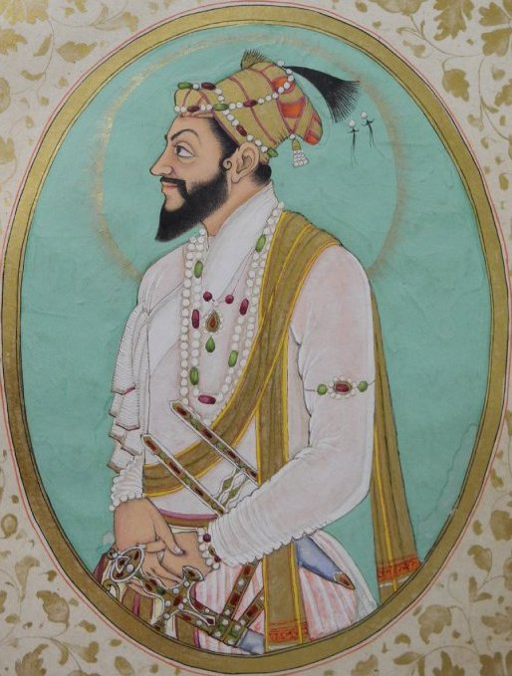
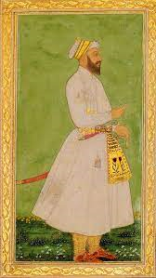
THE RULE OF THE SUBADARS IN BENGAL
Shah Suja (1639-1659 A.D.): Second son of Emperor Shahjahan. Quite peaceful reign. The English merchants enjoyed special favors during this time, and they increased their power. When Emperor Shahjahan fell sick in 1657 A.D., his four sons revolted because each wanted to be the Emperor. In the battle of the two brothers, Aurangzeb and Shah Suja, Suja was defeated in 1659 A.D.
Mir Jumla (1660-1663 A.D.): Came to Bengal to subdue Suja. Emperor Aurangzeb made him the Subadar of Bengal. As an efficient Subadar, he annexed Assam and Cooch Bihar to the Mughal Empire. Was succeeded by Dilir Khan and Daud Khan Abbasi after his death.

Slide 14
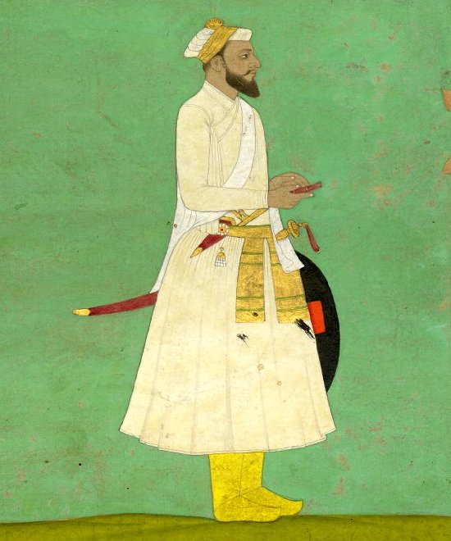
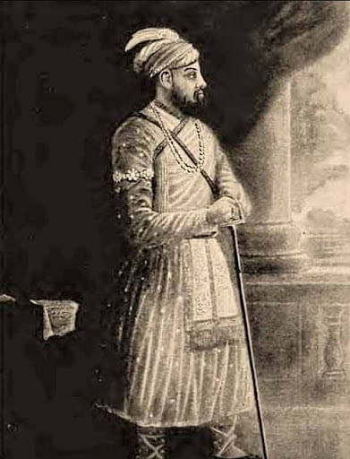
THE RULE OF THE SUBADARS IN BENGAL
Shayesta Khan (1664-1678 A.D., September 1679-1688 A.D.): Maternal uncle of Aurangzeb, a very efficient and farsighted administrator. He drove away the Portuguese pirates and occupied Chittagong. Towards the end of his reign, there was a dispute with the English East India Company. After a prolonged attempt he drove away the English from Bengal stopping the growth of their power. After him, Khan Jahan Bahadur, Ibrahim Khan and Azimuddin became Subadars (1688-1717), but were not very efficient.
Murshid Kuli Khan (1717-1727 A.D.): Formerly Diwan of Bengal came to power as an efficient Subadar during the reign of Emperor Farruk Shiar. Famous for the reformation of revenue system. After the death of Aurangzeb, the weak emperors could not give attention to the distant Subas. So the Subadars were quite independent. Murshid Kuli Khan was not any difference. He pledged loyalty to the Emperor only by name and used to send him an amount of one crore three lakhs rupees annually as taxes. From his time Bengal was almost independent the rule of the Nawabs started.

Slide 15
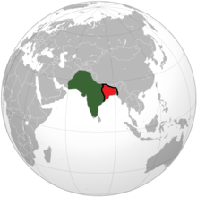
ADMINISTRATION – MUGHAL PERIOD
The province or Subah was divided into Sarkars and Parganas or Mahals.
With Mughal conquest, the kingdom of Bengal turned into a Province (henceforth called Subah) of the Mughal empire. For administrative convenience the Subah was divided into a number of Sarkars which were further sub-divided into Mahals or Parganas.
As the head of the provincial administration, the Subahdar had twofold responsibilities, i.e, the defense of the province, along with the maintenance of peace and order, and civil administration.
The Sarkar: Under the Mughals the Subah of Bengal was divided into 19 Sarkars, each of which was placed in charge of a Faujdar (military head). Appointed by the emperor on the advice of the Wazir.
The Faujdar was responsible for the maintenance of peace and for proper implementation of imperial edicts. Working under the close supervision of the Subahdar, the Faujdar assisted the revenue officials in collecting dues from Zamindars and Raiyats.
Each Sarkar was divided into a number of Parganas. There were 628 parganas. The pargana was mainly a revenue unit. The Amil was the chief of a pargana and there were Amins, Karkuns and Qanungos to assist him.

Slide 16
ADMINISTRATION – PARGANAH
The Subah of Bengal was divided into 19 Sarkars, each of which was placed in charge of a Faujdar (military head). The faujdar was responsible for the maintenance of peace and for proper implementation of imperial edicts. Working under the close supervision of the Subahdar. The faujdar assisted the revenue officials in collecting dues from recalcitrant Zamindars and Raiyats.
The Parganah or Mahal: Each Sarkar was divided into a number of Parganas. There were 628 parganas in Bengal. The pargana was mainly a revenue unit. The Amil was the chief of a pargana and there were Amins, Karkuns and Qanungos to assist him. Since the revenue collection involved some law and order situation. The pargana staff was required to perform administrative duties as well. These aside, there were some semi-government personnel called Chaudhuris who represented the peasants to the proper authorities concerning their rights and privileges. The Muqaddam (village headman), on the other hand, assisted the revenue personnel in the smooth collection of rents and helped maintain peace and order in the locality.

Slide 17
ADMINISTRATION – SUBAH
Other officers: The two officers - Subahdar and Diwan shared responsibility for the whole provincial government. They were assisted by other provincial officers. There were:
Subahdar
The Diwan (Finance Head)
Bakshi (Pay master of the army)
Sadr (Head of religious department, charity and grant)
Qazi (Judge)
Kotwal (Superintendent of police)
Mir-bahr (Admiral)
Waqianavis (News reporter)

Slide 18
ADMINISTRATION – SUBAH
The Subahdar, appointed by the emperor on the advice of the Wazir-e-Ala (Prime Minister) usually for a period of 4-5 years, was under the direct control of the centre. Though they worked under the general supervision of the Subahdar, the provincial officers were in reality responsible to their counterparts at the centre. Such a system of checks on the authority of the provincial administration made it difficult for the Subahdars to put undue pressure on subordinate officers or neglect their duties.
The weakening of central authority and its increasing dependence on the flow of revenues from Bengal led to the establishment of the semi-independent Nawabi rule in Bengal soon after the death of Aurangzeb (1707). Apart from the Subahdar, the province had some other important officers like the diwan, Bakhshi, Sadr, kotwal, Mir bahr, and Waqianavis.

Slide 19
Administration – Subah
The Diwan: Below the Subahdar, but not subordinate to him, was the Diwan appointed by the central government. He was also responsible to the government for revenue administration and civil justice.
As the head of the finance department, the provincial diwan's main function was to oversee revenue administration. The diwan controlled the income and expenditure of the Subah, an advantageous position that made the former dependent on the latter in matters of the required funds. The system of appointment of the provincial diwan by the emperor fell into disuse during the time of Murshid Quli khan, who wielded both the responsibilities of Diwan and Subahdar. Subsequently, the provincial Diwan was appointed by the nawab-Subahdar with the mere approval of the emperor whose control over the Subah.
The diwan was to be in constant touch with the revenue staff in the pargana, the hub of rural administration. It was in his office that all the returns of assessment and realization of revenues from the parganas were audited and consolidated into abstracts for transmission to the central ministry of finance.

Slide 20
ADMINISTRATION – SUBAH
The Bakhshi, the counterpart of the Mir-Bakhshi (central Bakhshi) in the province, was responsible for the proper administration of the military department. He used to supervise the training, efficiency, and discipline of the armed forces maintained by the Mansabdars. He also advised the Subahdar on military affairs and when necessary, made arrangements for expeditions.
The provincial Sadr (Head of religious department, charity and grant) mainly looked after religious affairs. In the absence of Qazis (Judge) the Sadr dispensed with judicial matters. He used to make recommendations to the central Sadr for grants of rent-free lands for religious and educational purposes (madad-i-mash), and other charitable grants.

Slide 21
ADMINISTRATION – SUBAH
As the chief of the police administration, the Kotwal maintained internal peace and security. Through a network of agents, he received information about the movements of unwanted elements and strangers in and around the capital and the towns.
The provincial Mir-bahr, had to maintain the river and sea ports in good condition, to guard and supervise river communications. The Mir-bahr was often required to assist the Subahdar and the Bakhshi by providing with his fleet.
The Waqianavis used to keep the central authority informed about happenings in the province. Assisted by a number of secret reporters (Sawanihnavis), Waqianavis used to send intelligence reports to the centre.

Slide 22
Administration – Mughal Period
No account of the administrative history of medieval Bengal would be complete without reference to the salient features of the revenue system. Based on local tradition and the revenue system developed by the Sultani administration, the Mughals built up a comprehensive system. Since the land was the mainstay of the Mughal economy, as in past regimes, agrarian matters got the proper attention of rulers. Realizing that the prosperity of the country depended on the well-being of peasants, the rulers took great care in protecting the interests of cultivators and encouraged them to bring more land under cultivation.

Slide 23
SIGNIFICANCE/IMPORTANCE OF MUGHAL RULE IN BENGAL
The period of imperial Mughal rule over Bengal witnessed the working of certain new forces which have completely transformed Bengali life and thought and whose influence is still operating in the province. Here is the several contributions that they have made:
International Connections: In the Sultanate, Bengal’s cultural contact with the outside Muslim world was limited chiefly to Makkah and Madina. In the Mughal period, such connections, particularly with Arabia, Iran and Turkey, increased largely.
Educational significance: The Mughal emperors were learned and liberal and possessed high moral principles. The high officers, like Wazir, Subahdar and Diwan etc., were also very learned and cultural people. They set examples of etiquette, tradition and polished manner to be emulated by others. The Subahdars maintained libraries in their residences and got books on history, philosophy, science and belles letters copied by calligraphists.

Slide 24
SIGNIFICANCE/IMPORTANCE OF MUGHAL RULE IN BENGAL
Contributions in literature: Contemporary Hindu literature composed by The Hindus was religion-based. But being influenced by Persian literature, poems dealing with love stories of men and women began to be the theme of Bengali literature. Persian literary works, particularly romantic stories, were translated into Bengali. Side by side, Bengali literature was also influenced by Hindi-Awadhi poetical works.
Cultural significance: Persian influenced the Bengali language and literature in a great way. Many Persian words entered the Bengali vocabulary. Many such words are still found not only in literature but also in the court circle and the day-to-day use of people.
Employment opportunities: Though the Muslims came to Bengal from the outside from the beginning, with the consolidation of Mughal authority, there was peace and prospects of employment opportunities increased. So scholarly Muslims like the Ulemas, Sufis, Teachers, Poets and Physicians came to Bengal in large numbers.

Slide 25
SIGNIFICANCE/IMPORTANCE OF MUGHAL RULE IN BENGAL
Religious significance: As the Mughals were liberal in religious matters, the non-Muslims could also practice their religion freely without interference. Besides, the lower-class non-Muslims accepted Islam either for mundane reasons, like gaining favours from the rulers or getting state services, or the teachings of Islam attracted them.
Administrative significance: The Mughal administrative and revenue system was so well thought out and well planned. During this period, one administration, one law, one official language, a uniform official cadre and uniform currency. Mughals established peace, good government and discipline. They freed the people from the oppression of the pirates.

Slide 26


